Slide 1


“SMART LPG, SMOKE AND FIRE DETECTION SYSTEM WITH AUTOMATED SAFETY RESPONSE”
PBL : CCE-2 Presentation on
By
VARUN .U. KUMBHARE [104]
MOHAN .M. JADHAV [114]
PRATIK .S. JAWALE [118]
Under Guidance of
SAYALI MANE
Department of Electronics and Telecommunication Engineering,
D. Y. Patil College of Engineering, Akurdi, Pune
2025-2026

Slide 2
Objective of Project
To detect the leakage of LPG gas, presence of smoke and fire using appropriate sensors.
To perform automatic safety actions such as turning OFF the gas regulator, activating the exhaust fan and triggering a fire extinguisher.
To alerts users through sound and visual indicators for immediate awareness.

Slide 3
Components
Microcontroller: Arduino UNO
Model: ATmega328P-based
Operating Voltage: 5V
Input Voltage: 7–12V
Affordable, widely supported, has sufficient digital/analog pins, and easy to program using Arduino IDE
Gas/Smoke Sensor: MQ-2
Detects LPG, Smoke, Methane, Propane, Hydrogen
Operating Voltage: 5V
Sensitivity Range: 200–10000 ppm gas concentration
Low cost, sensitive to LPG and smoke, reliable for indoor leakage detection

Slide 4
Flame Sensor Module
Detects infrared (760–1100 nm flame light)
Operating Voltage: 3.3V–5V
Detection Range: 0.8–1.5 meters
Fast flame response, low cost, and compatible with Arduino
Buzzer (Active 5V)
Active buzzer (internal oscillator)
Voltage: 5V
Sound Level: 85 dB
Produces alert sound immediately without delay
Solenoid Valve (LPG Gas Cut-off)
Operating Voltage: 12V DC
Current Rating: ~300–500 mA
Port Size: ½ inch (standard for LPG regulator connection)
Function: Normally closed (opens only when energized, used to stop gas supply during leakage).
✅ Water Pump (Mini DC Motor Pump)
Operating Voltage: 12V DC (commonly 5–12V range available)
Flow Rate: ~1–3 liters/min (depends on pump size)
Current Rating: ~300 mA – 1A
Application: Used for water dispensing/extinguishing small flames.

Slide 5
4-Channel Relay Module
Control Voltage: ~5V
Load: up to 10A 250V AC / 30V DC
Controls high-voltage devices (like exhaust fan, solenoid, extinguisher motor)
Exhaust Fan
Voltage: 12V DC
Current: ~300–500 mA
Removes leaked gas from room to avoid buildup of combustible atmosphere
Power Adapter
Type: 12V DC Adapter
Current: ≥ 1A
Powers all modules through a regulated power supply

Slide 6
LED + Resistor
LED: 5 mm (Red, Green, Yellow)
Resistor: 220 Ω – 330 Ω
Why: For status indication; resistors prevent LED burnout
Breadboard + Jumper Wire
Breadboard: 400–800 point
Jumper Wires: M-M, F-F, M-F
Rapid prototyping and wiring without soldering
PCB
For final soldered version after testing

Slide 7
Literature Survey
Year | Title | Components Used | Summary
2020 | LPG Gas Leakage Detector | Flame Sensor , MQ-2 Sensor , Arduino UNO , Buzzer , LEDs, Solenoid Valve | This system detects both LPG gas leaks and fire flames using MQ-2 and Flame Sensors with an Arduino UNO , when danger is identified , it triggers an alarm via buzzer and LED and automatically shuts OFF the gas using a Solenoid Valve.
2024 | LPG Gas Leakage Safety System | MQ-2, MQ-6 Sensors , Servo Motor, Buzzer | This IOT Enhanced design uses MQ-2 and MQ-6 Sensors for LPG leak detection and deploys a Servo Motor to automatically turn OFF the gas regular based on Blynk app readings and local Buzzer alerts.
2023 | LPG Leakage Detection Device | MQ-2 Sensor, Buzzer , LED | The paper addresses the dangers of LPG leaks in household environments , an important concern due to LPG’s flammable nature and risk of explosion. The authors aimed to design a simple, effective alert system named “T or-G” to detect leaks and warn users quickly using a microcontroller based setup.

Slide 8
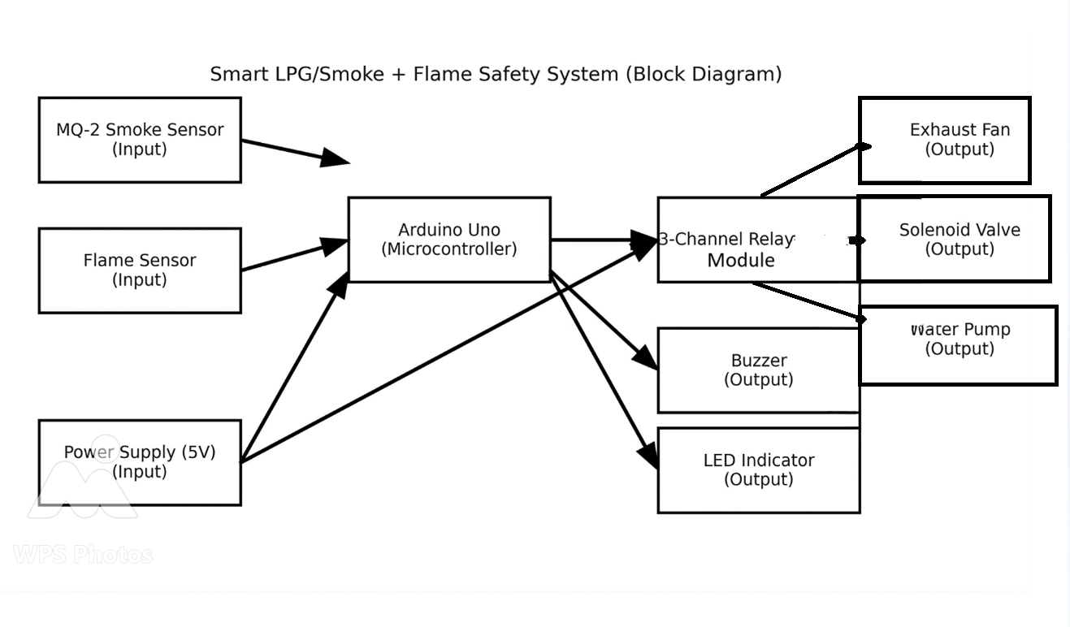
Block diagram of Project

Slide 9
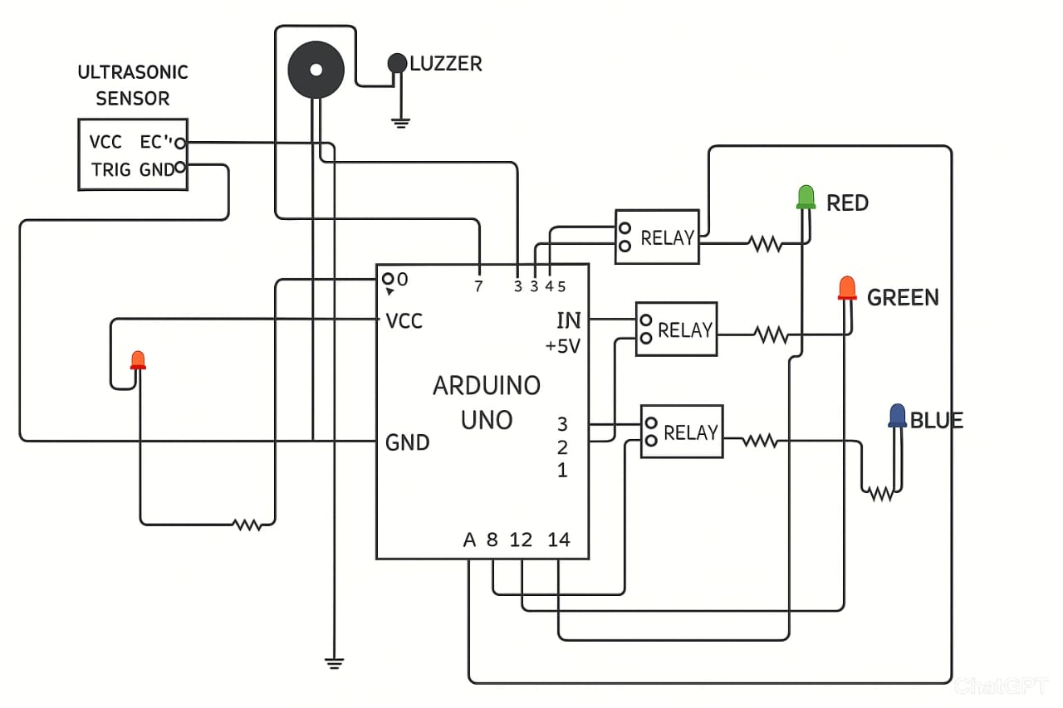
Circuit diagram of Project

Slide 10
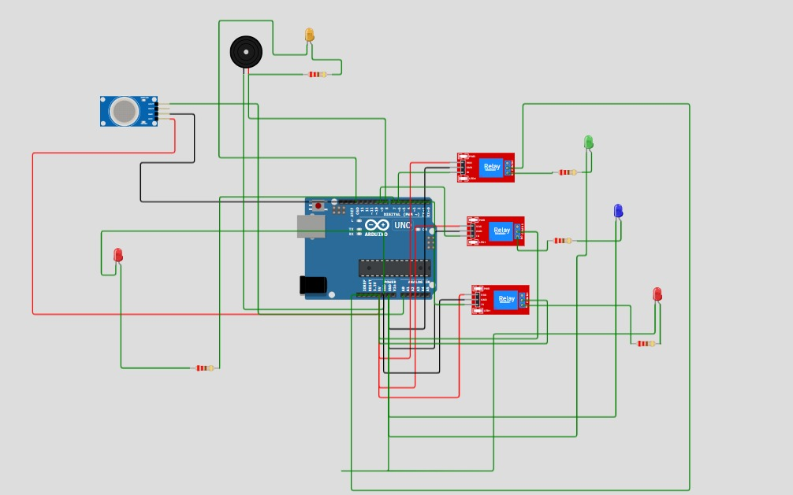
Simulation of Project

Slide 11
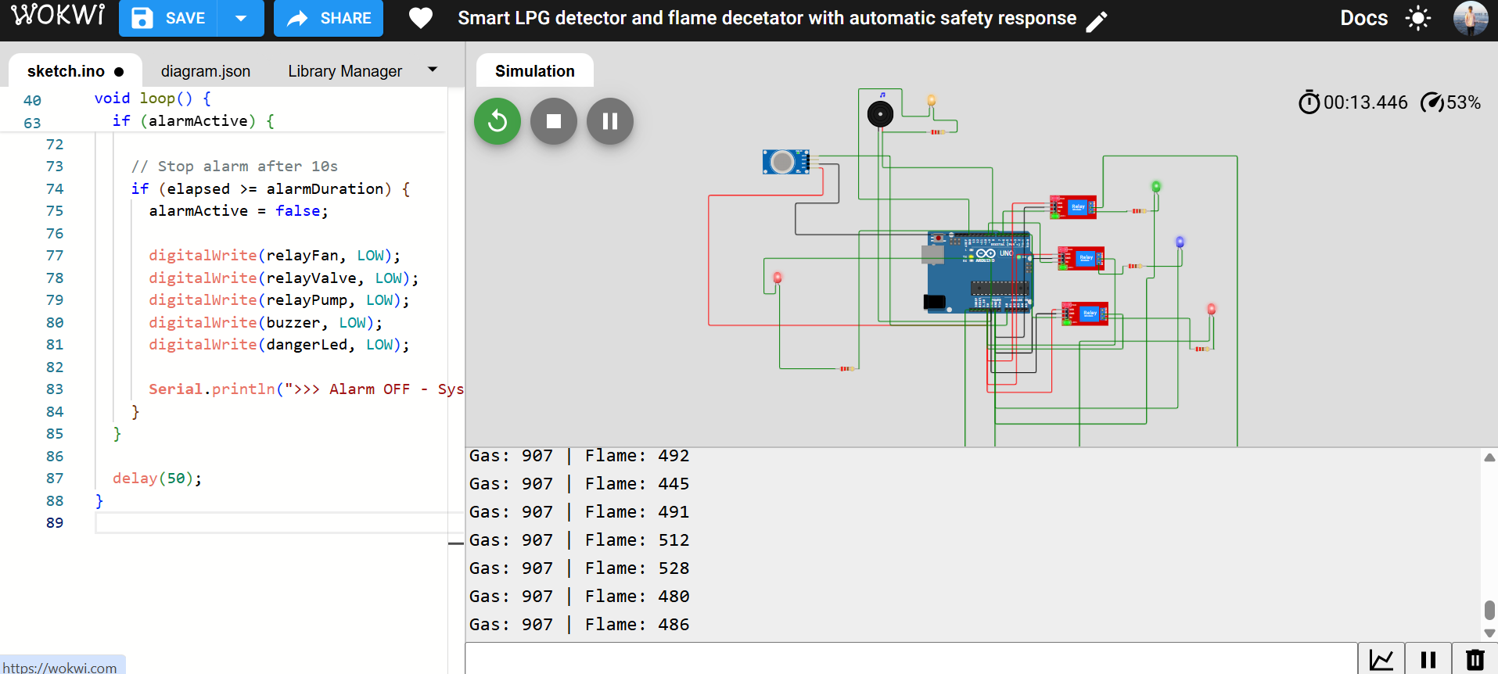
Simulation Working

Slide 12
Conclusion
The highlight of this system is its fully automatic operation, requiring no human intervention at the time of emergency, thereby minimizing the risk of accidents, property loss, and saving human lives.
This project proves that with low-cost components and simple automation, we can build a highly reliable and practical domestic and industrial safety solution. It not only enhances safety but also sets the foundation for future upgrades such as GSM-based SMS alerts, IoT integration for mobile monitoring, and AI-based early warning systems.
Hence, the project achieves its objective of combining safety, automation, and innovation, making it a valuable step toward smart home and industrial safety applications.

